Slide 1
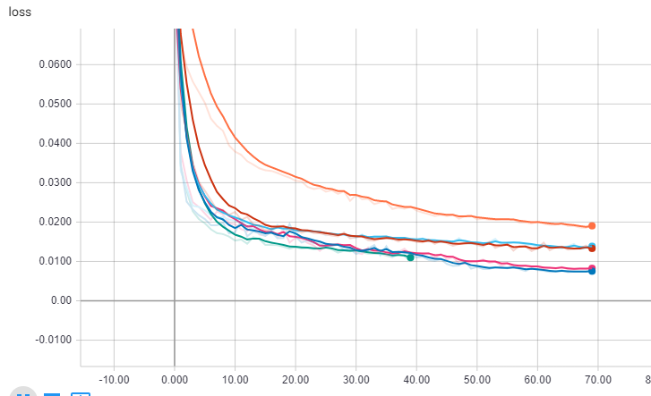
Axis Bank Experiment
Understanding Learning Rate Impact:
Stock code – AXISBANK
Epoch : 80
Time-steps : 60
LSTM ( 3 layers ) + 1 Dense
Prediction size – 10 days
Learning Rates :
Fix Learning Rate with SGD
Adam
Adadelta
Adagrad
RMSProp
Fix SGD
Adam
Fix learning rate shows gradual decline in loss but tends to saturate after 50 epochs
Adadelta, Adagrad and RMSprop shows good improvement to reduce loss but could not shows incremental loss decline after 30-40 epochs
Comparatively ‘Adam’ shows gradual decline in loss over an incremental epochs

Slide 2
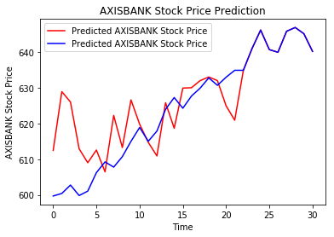
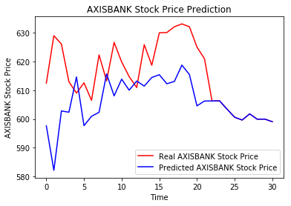
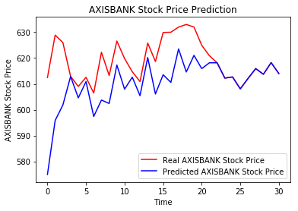
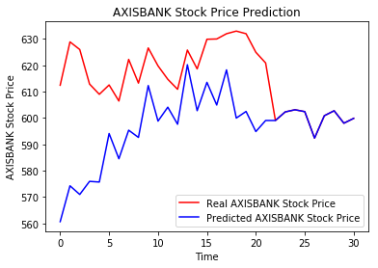
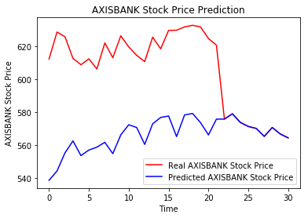
Axis Bank Experiment
SGD – FixRate
Adam
Adadelta
Adam and Adadelta shows closeness to the real priceline
Adagrad
RMSProp

Slide 3
Axis Bank Experiment
Open prices | FixLearn | Adam | Adadelta | Adagrad | rmsprop
610.25 | 634.883 | 606.25 | 618.161 | 599.057 | 575.905
602.4 | 640.951 | 606.299 | 612.231 | 602.315 | 579.128
595 | 646.157 | 603.397 | 612.684 | 603.133 | 573.878
581 | 640.682 | 600.62 | 608.066 | 602.427 | 571.421
604.75 | 639.928 | 599.643 | 612.065 | 592.375 | 570.212
624.8 | 645.811 | 601.783 | 615.914 | 600.877 | 565.383
619.1 | 646.871 | 599.927 | 613.723 | 602.755 | 570.798
622.55 | 645.131 | 599.967 | 618.234 | 598.028 | 566.867
617.65 | 640.184 | 599.07 | 614 | 599.868 | 564.475
Area of focus
Open | FixLearn | Adam | Adadelta | Adagrad | rmsprop
0.0% | -4.0% | 0.7% | -1.3% | 1.8% | 5.6%
0.0% | -6.4% | -0.6% | -1.6% | 0.0% | 3.9%
0.0% | -8.6% | -1.4% | -3.0% | -1.4% | 3.5%
0.0% | -10.3% | -3.4% | -4.7% | -3.7% | 1.6%
0.0% | -5.8% | 0.8% | -1.2% | 2.0% | 5.7%
0.0% | -3.4% | 3.7% | 1.4% | 3.8% | 9.5%
0.0% | -4.5% | 3.1% | 0.9% | 2.6% | 7.8%
0.0% | -3.6% | 3.6% | 0.7% | 3.9% | 8.9%
0.0% | -3.6% | 3.0% | 0.6% | 2.9% | 8.6%

Slide 4
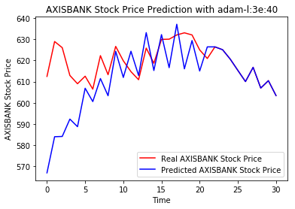
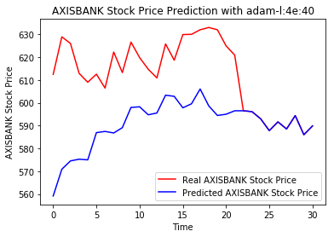
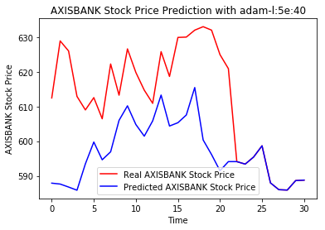
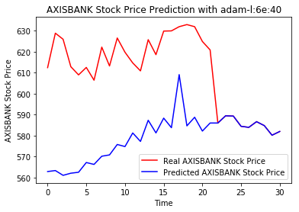
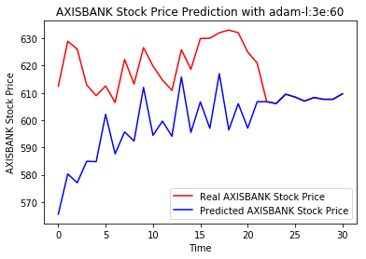
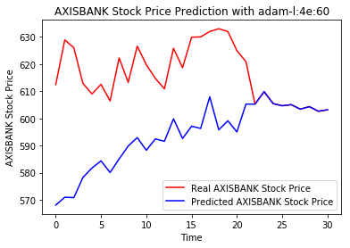
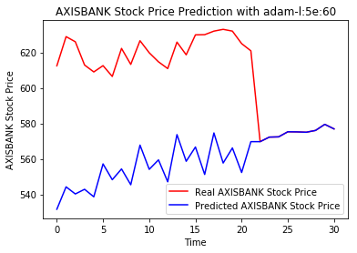
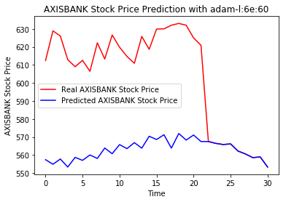
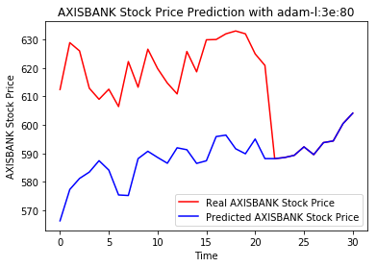
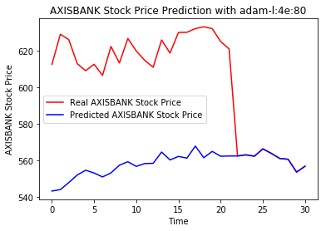
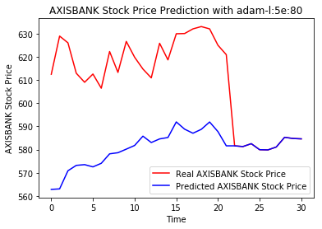
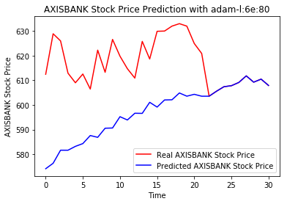
Axis Bank Experiment – with Adam
Over engineering of adding layers & epochs does not help !!!!
Dotted charts shows balanced numbers of layers and epochs
￼
￼

Slide 5
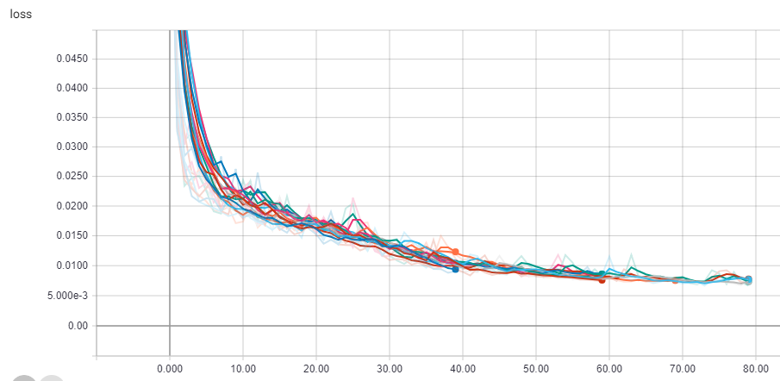
Axis Bank Experiment

Slide 6
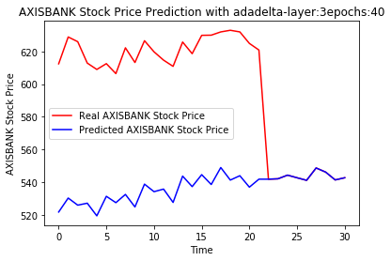
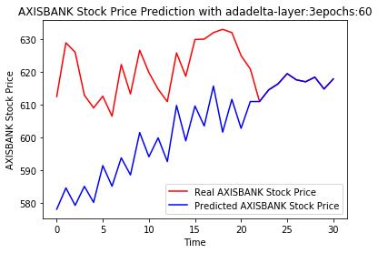
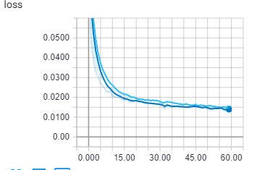
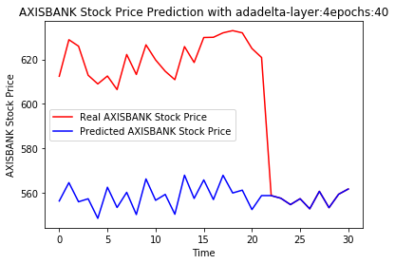
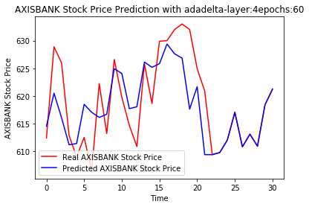
Axis Bank Experiment – with Adadelta
Skyblue – 4 layers / 60 epochs
Darkblue – 3 layers / 60 epochs
Increasing one layer shows improvement in closeness to curve
Additional epochs reduces the variance
￼
￼

Slide 7
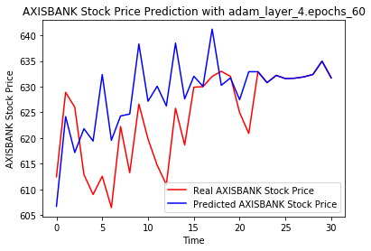
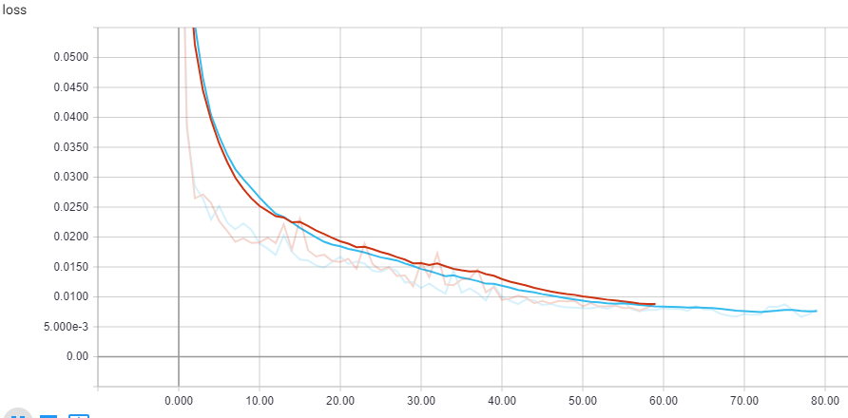
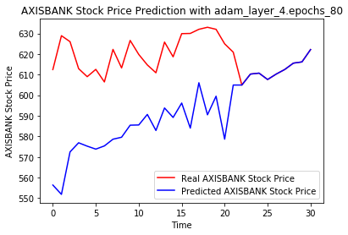
Axis Bank Experiment – with adam
Need to understand –
- Loss in decreasing by adding epochs from 60 to 80 but its increasing variance

